Slide 1
Causes (STEPS) of the American Revolution

Slide 2
French and Indian War
Fought between the British and French and their allies of Native Americans on both sides.
Fought in the Ohio River Valley area, Appalachian Mountain region
Fought over territory and the fur trade
The British won the war but had huge amounts of debt because of the borrowing to pay for the war.
It was ended by the signing of the Treaty of Paris of 1763.
Proclamation of 1763 made it illegal for colonists to cross west of the Appalachian Mountains to settle in the Ohio River Valley

Slide 3
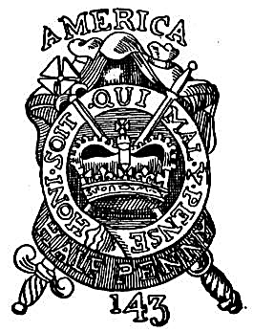
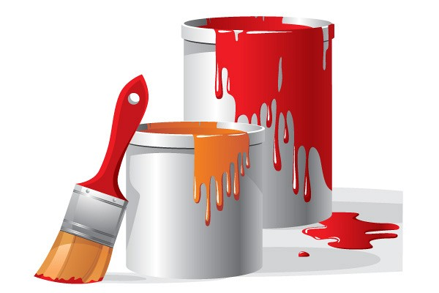
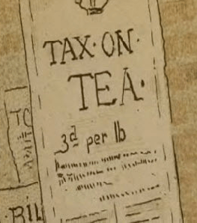
Sugar Act, Stamp Act, Quartering Acts, Townshend Acts
A series of Acts one after another that put taxes or take actions on things that directly effected the colonists and their day-to-day lives.
Sugar Act – taxed sugar and molasses
Stamp Act – taxed paper goods, cards, envelopes, stationary, etc.
Quartering Act – colonists had to house and feed British soldiers
Townshend Acts – tax on paper, lead, paint, glass, and tea

Slide 4
Boston Massacre
In 1770, a group of colonists were rioting at a customs house. They were tired of British policies and especially of having British soldiers in their homes.
They began throwing snowballs, sticks, rocks, actually attacking the soldiers.
This led to British troops opening fire on the colonists, killing three and wounding a few more.
This engraving by Paul Revere, left, depicts an entirely different scene. How does it differ from actual accounts of the event?

Slide 5
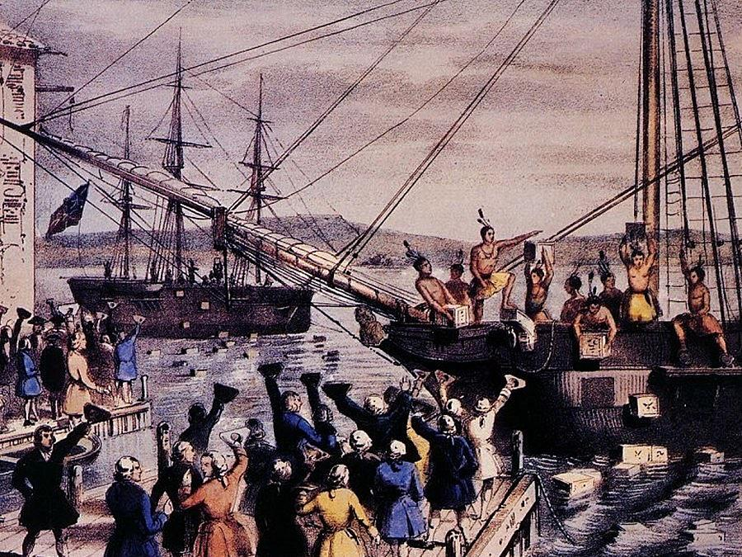
Boston Tea Party
A colonial protest group called the Sons of Liberty led by Samuel Adams and Patrick Henry dressed up as Mohawk Indians and climbed aboard ships in the Boston Harbor and threw British tea in the harbor to protest the British Tea Tax imposed on the colonies.
This event led directly to the Intolerable (Coercive Acts)

Slide 6
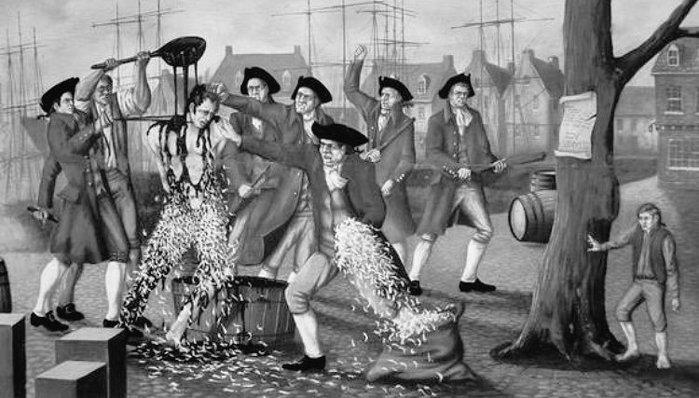
Intolerable Acts
The British Government decided the colonists needed punishment for their illegal act of throwing tea into the Boston Harbor
The punishment are as follows:
Closed the Boston Harbor for transport and trade
Colonists had to pay back the cost of the tea
Expanding the Quartering Act
British officials charged with crimes could be tried in different locations than Boston
Town Meetings were forbidden without approval (which they wouldn’t get)

Slide 7
First Continental Congress
In response to the Intolerable/Coercive Acts, the colonies gathered in Philadelphia in 1774 at what we call the First Continental Congress.
At this Congressional meeting, the colonies were divided as to gaining independence from Britain. Some wanted to remain loyal and some wanted a split.
The representatives from the colonies (except Georgia) decided to give peace one more chance and they wrote out their grievances to send to King George.
Massachusetts led the resistance to Britain’s policies, forming militias to resist.
King George ignored the demands of the colonists in their list of grievances.
Grievances – a problem, a trouble, a disagreement you wish to fix

Slide 8
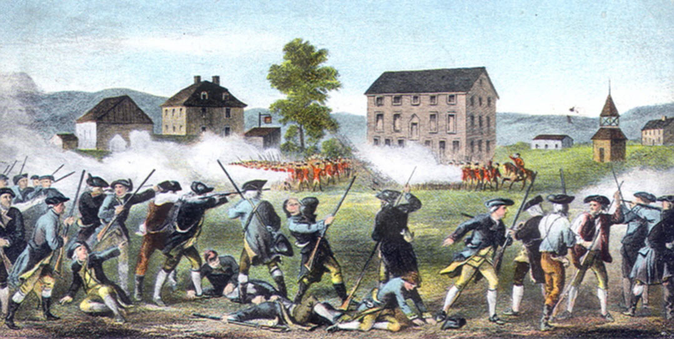
Battles of Lexington and Concord
Often referred to as “the shot heard ‘round the world” because a colony was fighting it’s mother country! It was unbelievable!
The militia (small private-citizen military force of colonists) stood their ground on April 19, 1775 in Lexington and Concord, Massachusetts as the British redcoats were ordered to take away their weapons.
The militiamen were outnumbered by the British. These men were called “minutemen” because they had to be ready to defend their towns at a moment’s notice.
No one knows who fired the first shot, (shot heard ‘round the world) but we do know that this was the first shot of the American Revolution and the first real steps toward independence from Britain.

